Slide 1
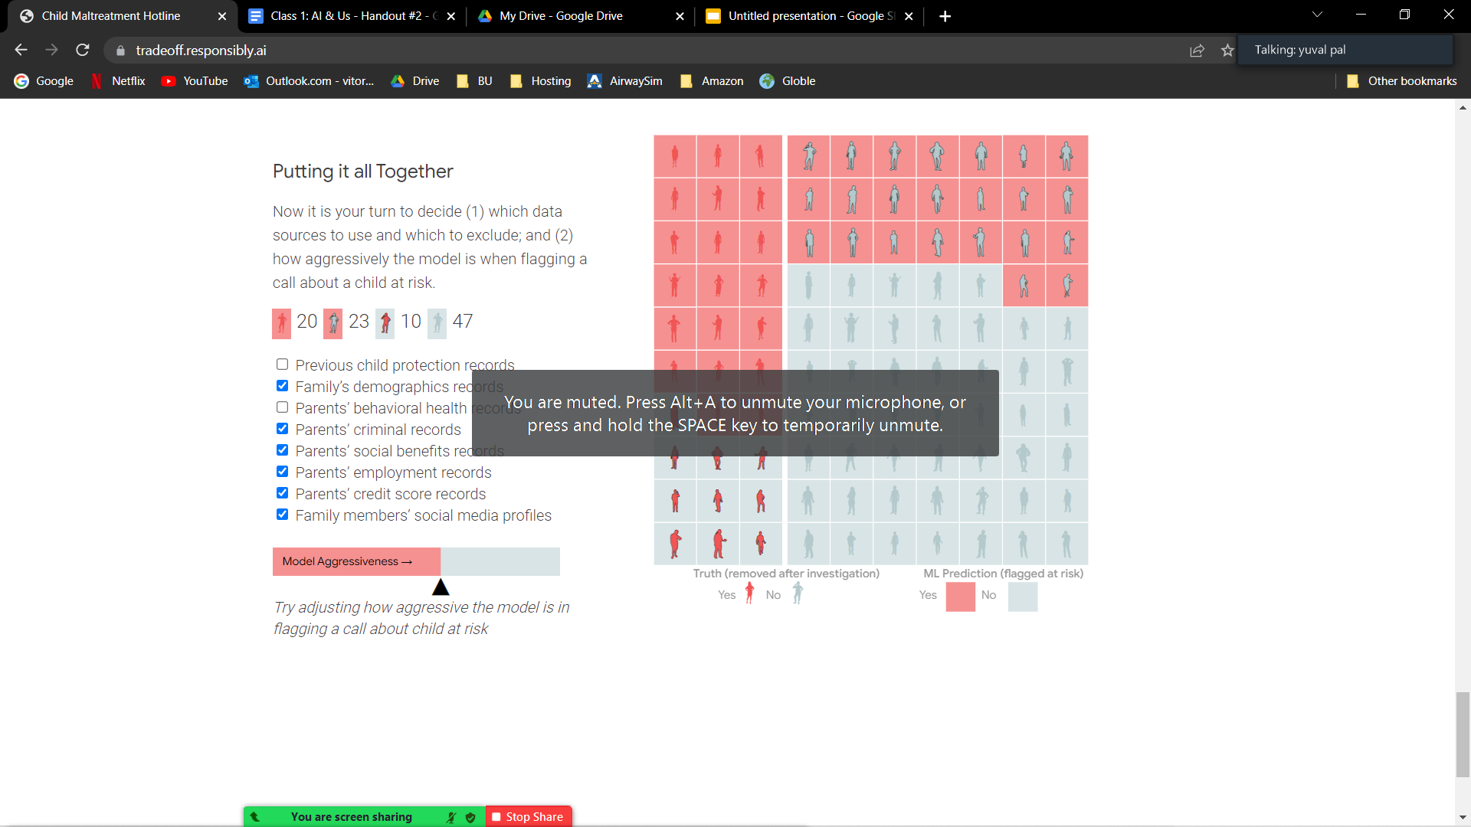
Team #9
Aggressiveness Level:
As an NGO, we want the aggressiveness level to be high enough to flag the require children, but also be aware that the government has a limited amount of resources to handle the calls, and want them to be used for the proper cases.
Previous child protection records
As an NGO we’d like to make sure that all the data regarding the children should be protected. We don’t want prior situations regarding the child to influence current situations, so as not to have a “Child who cried Wolf” situation.
Family’s demographics records
We are aware that it can happen in every family, but these statistics are directly related to the conditions in which the child lives. DISCLAIMER: Not all demographics should have the same influence (it’s very different to train a model base on Race than based on Living Conditions).
Parents’ behavioral health records
This data breaches a lot on the privacy of the people involved, and, as such, is out of bounds.
Everything else is fair game.

